Slide 1
University Advising Services
Professional Development for Spring Semester

Slide 2
Agenda
Generational Research
Who are these students?
Problems with Generational research
Transitional Phases for First-Year Students

Slide 3
Generational Research

Slide 4
Generational Definitions
This generation grew up during the early years of the era, and lived through the difficulties of the major cultural event of their time. They tend to be much more conservative, and hold traditional values.
The only society they have ever known has transformed itself upside down from a society where the elderly are respected, to a “Little Emperors” society where the child is spoiled and given every privilege by their parents and grandparents.
Grew up only knowing a very prosperous nation. This generation has also grown up being doted on by their parents and grandparents.
Not only that, the teachers and parents of this generation are increasingly those of the previous generation. Thus those who are influencing the current generation have not been as influenced by conservative ideas as in the past.
Post 70’s- Conservatism
Post 80’s- Privilege
Post 90’s- Prosperity

Slide 5
Generations are Cultural and Fluid
Japan
  The Elders (1949-74)
  The Midcareer Cohort (1975-88)
  The Youngest Cohort (1989-)
Japanese Americans
  Issei
  Nisei
  Sansei
  Yonsei
  Gosei

Slide 6
Who Are These Students?

Slide 7
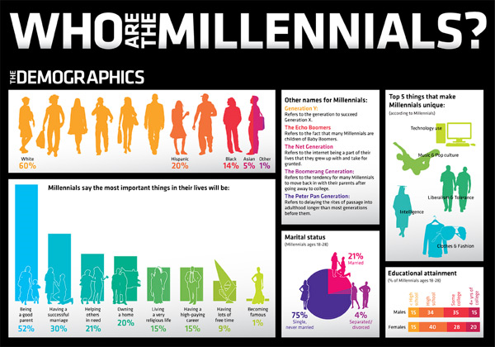
Millennials

Slide 8
Millennials
Special
Sheltered
Confident
Team-Oriented
Achieving
Pressured
Conventional

Slide 9
An interlude...

Slide 10


Slide 11
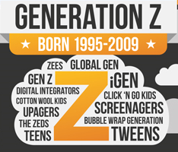

Slide 12
Gen-Z, iGeneration, etc., etc.
Born between 1995-2000 (dates vary)
64 Million
Received Phone
Average Age of 9
More Budget Conscious

Slide 13
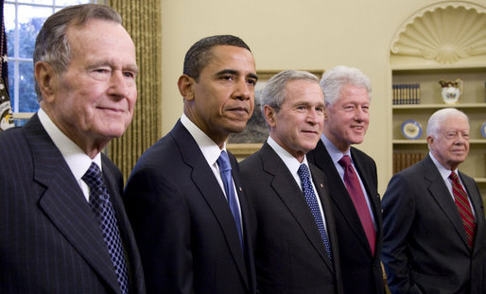
Their world...
Biggie has always been dead
Chris Farley has always been dead
South Park has always been on
Hong Kong has always belonged to China
Sheep have always been cloned
Presidents have always had two terms
Columbine- 2 years old
9/11- 4 years old
Hurricane Katrina- 8 years old
iPhone- 10 years old
Deepwater Horizon- 13 years old

Slide 14


Slide 15
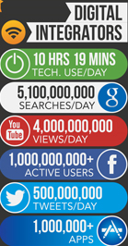
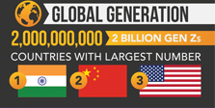
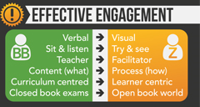

Slide 16
How to Motivate These Students...
Create high-intensity relationships: They react better to highly defined, small workgroups that have a strong peer leader. There must be an easy to identify chain of command when it comes to management
Generation Z students may need more training, especially in the area of interpersonal and communication skills. Focus on behaviors--show them the right skills and communication techniques.
Provide lots of awards: This generation has grown up used to rewards for even the smallest accomplishment. To encourage performance and growth, offer periodical rewards and continue redesigning the rewards to meet the changing expectations.
Generation Z students thrive on opportunity. If you want to keep them interested and motivated, show them a dream opportunity is possible.

Slide 17
Differences between Millennials and Zs
Millennials
Generation Z
Millennials spent money boldly and with few boundaries
Millennials grew up during a strong economy
Millennials subscribed to everything social
Millennials watched YouTube, Hulu and Netflix
Millennials loved sports and adventure
Millennials grew up with slightly longer attention spans
Millennials would initiate text for communication
Millennials enjoyed a life that revolved around them
57 percent of Generation Z prefers saving money to spending it.
Generation Z is growing up in a time of recession, terrorism, violence, volatility and complexity.
Generation Z does not wish to be tracked and prefers more private networks like Snapchat, Whisper, Secret, and Yik Yak.
Generation Z creates content and interactive work.
Generation Z sees sports as a health tool, not for play. Their games are inside. Teen obesity has tripled since 1970.
Generation Z has an attention span of 8 seconds.
Generation Z prefers communicating through images, icons and symbols.
Generation Z plans on coping with multi-generational households and marriages (400 percent increase).

Slide 18
Generation Z
They multitask on five screens, not one or two. They experience FOMO: the "Fear Of Missing Out." They try to consume it all.
They plan to get educated and start working earlier, but will be "school hackers" and not necessarily attend a liberal arts college.
75% wish their current hobby could become their full-time job.

Slide 19
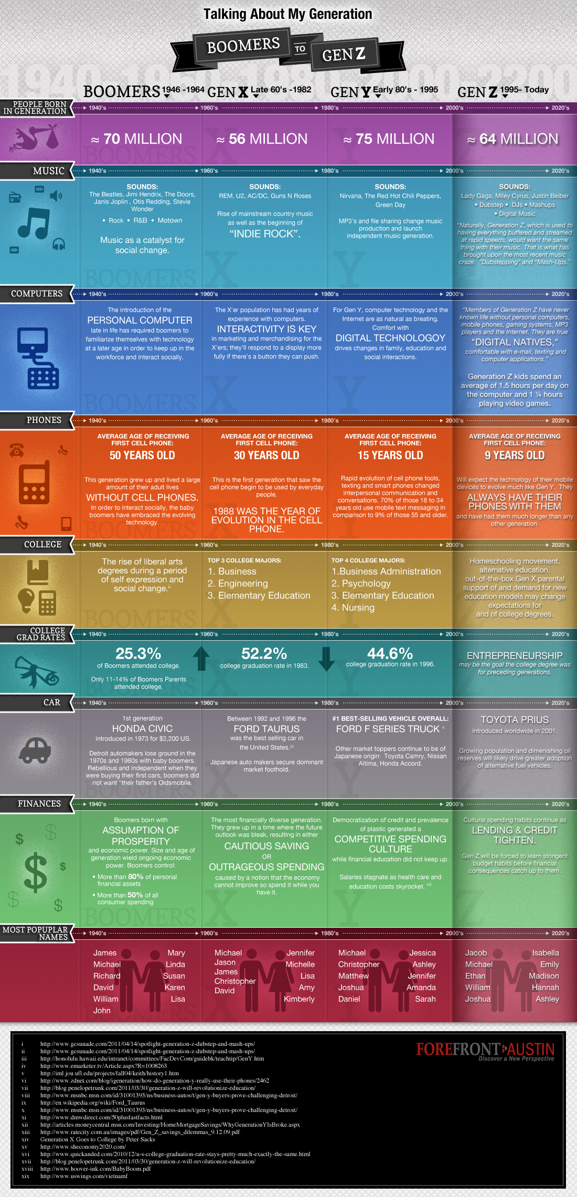
The Problems with Generational Study

Slide 20
Transitional Phases of First-Year Students

Slide 21
Early in the Semester
End of First Semester
Beginning of 2nd Semester
The Honeymoon
The End of the Honeymoon
Separation Anxiety
First Visit Home
Thoughts of Transfer
Learning to Cope
Fear of Failure
Integrated into campus and schedule
Confidence has grown
More aware of opportunities

Slide 22
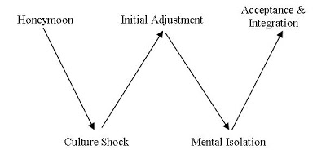
The W-Curve of Student Transition
(Zeller and Mosier, 1993)

